Slide 1
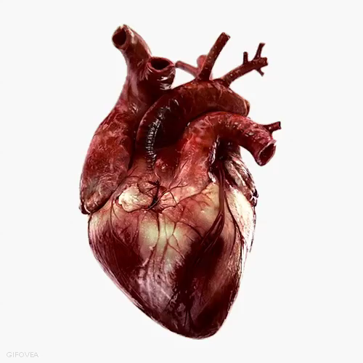
CARDIAC OUTPUT

Slide 2
Cardiac Vocabulary
Contractility: the force that the muscle can create at a given length.
Preload: Preload is the volume of blood that the ventricle must pump
Afterload: Afterload is the pressure that the ventricle must contract against

Slide 3
Cardiac Output
Cardiac output is controlled to maintain the proper amount of flow to tissues and to prevent undue stress on the heart.

Slide 4

Frank-Starling Law
What goes into the heart comes out.
Increased heart volume causes the muscles to stretch = stronger contractions and heart rate

Slide 5
Cardiac Output
Cardiac Output is the volume of blood pumped each minute
CO = SV x HR
Where:
CO is cardiac output (mL/min )
SV is stroke volume (mL per beat)
HR is heart rate (beats per minute)

Slide 6
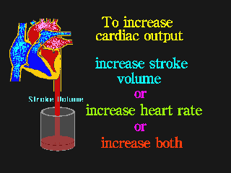

Slide 7
Heart Rate (HR)
Adult HR is normally 80-100 beats per minute (bpm)
Stroke Volume (SV)
The volume of blood pumped with each heart beat.
Is determined by preload, afterload, and contractility.

Slide 8
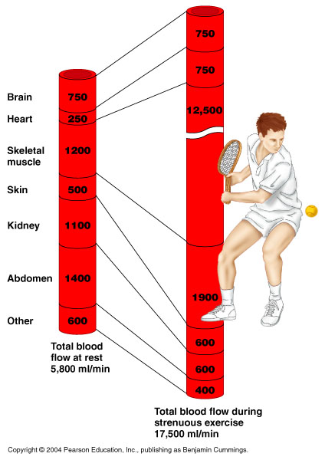

Slide 9

Cardiac Reserve
Cardiac reserve is the difference between resting and maximal CO

Slide 10
Factors that increase HR
Can you get 5 things?

Slide 11
Factors that increase HR
Body temperature: hot = increase and cold = decrease
Exercise: the more strain on muscles the more your HR increases
Eating: after eating your HR increases to aid digestion
Age: your maximum HR decreases with age (not your resting HR)
Gender: women have higher HR then men.
Medications/drugs: many are stimulants and increase HR while others can block hormones and cause a decrease in HR
Illness: when your sick or injured your HR changes
Emotional stress: fear and anxiety can stimulate a persons HR due to a change in hormones
Dehydration: your blood become thicker and your HR increases as it has to work harder

